Slide 1
RIVER SURVELLING SYSTEM
PROBLEM STATEMENT-
GETTING THE POINT SOURCE OF POLLUTION IN THE RIVERS BY LIVE DATA HANDLING THROUGH FLOW METER

Slide 2
SOLUTION-
WE ARE DEVELOPING AN RIVER SURVELLING SYSTEM WITH THE HELP OF FLOW METER.
A SET OF FLOW METERS IS PLACED ON A ROPE WHICH IS PLACE ON A SITE OF A RIVER FROW BANK TO BANK WHICH IS CALLED ONE STATION.
A PART OF RIVER IS DIVIDED INTO SUCH STATIONS.
FIRSTLY WE SET A BENCH MARK OF RATE OF FLOW OF WATER IN THE SEGMENT OF RIVER
ON TAKING LIVE READINGS FROM TH FLOW METERS
IF THE AVG VALUE OF ALL THE FLOW METER AT THE STATION IS LESS THEN THE BENCH MARK
READING THEN POLLUTANTS ARE PRESENT BEFORE THAT STATION .
THROUGH THIS WE GET TO KNOW ABOUT THE SEGMENT OF THE RIVER WHICH IS POLLUTED
AND THEREBY WE HAVE TO WORK ON THAT SEGMENT OF THE RIVER ONLY.

Slide 3
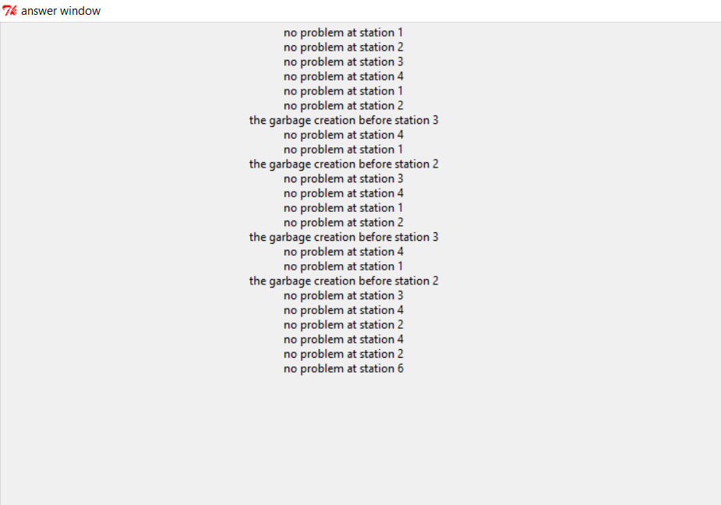
OUTPUT WINDOW
GIVES INFORMATION ABOUT THE POLLUTION
RATE AT DIFFERENT STATIONS

Slide 4
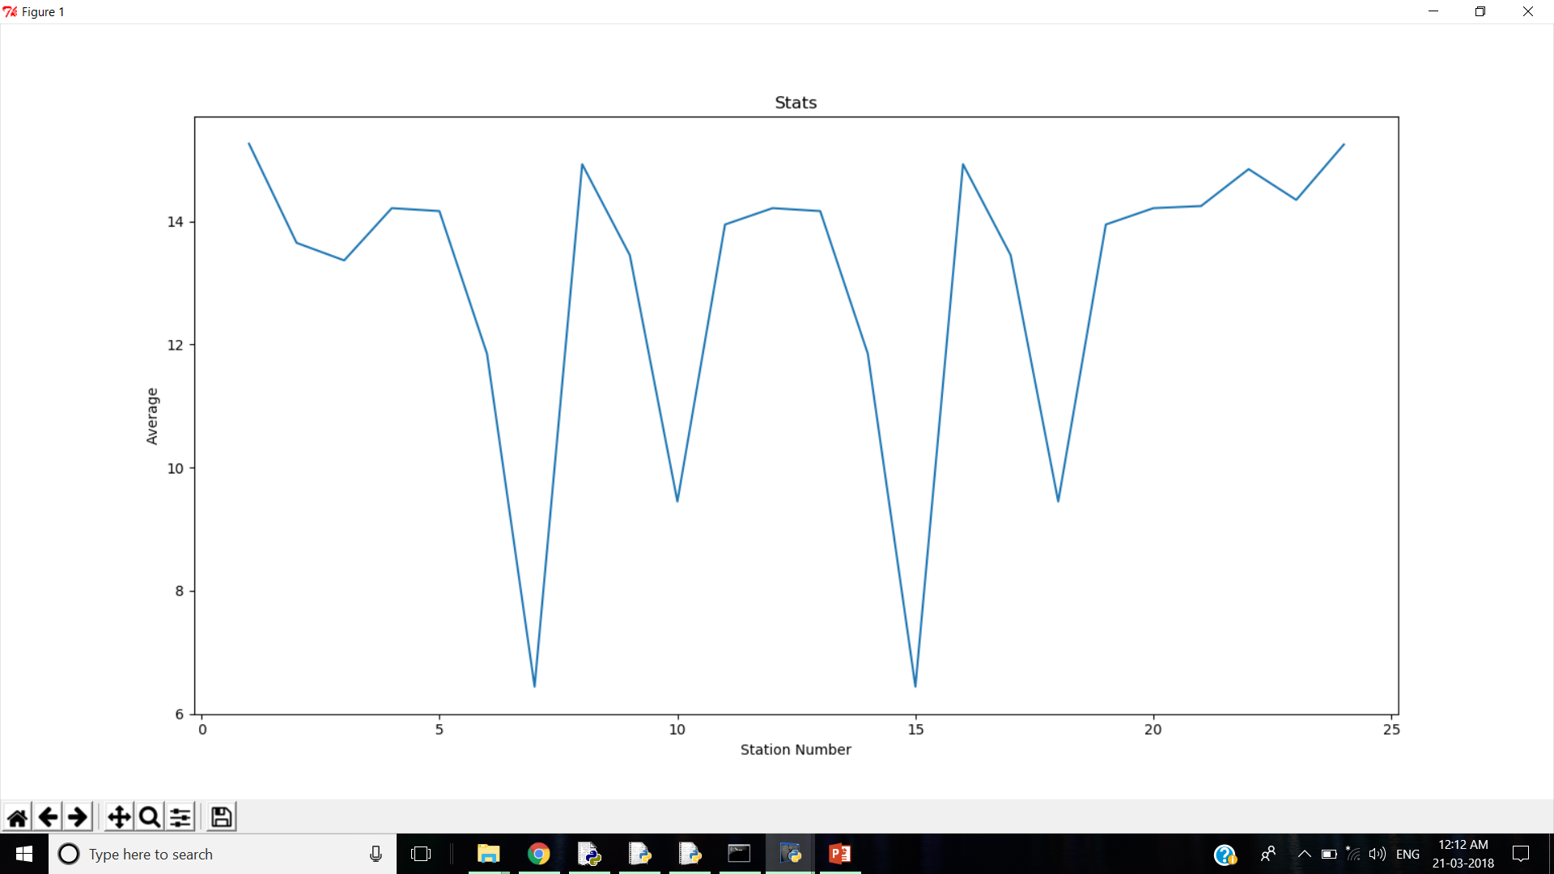
GRAPHCAL OUTPUT OF READINGS THROUGH FLOWMETER

